Slide 1
ONLINE ADVANCE SMART BOARD
Guided by Represented By
Mr. Rajesh Singh Namrata Kumari(13/174)

Slide 2
INTRODUCTION
The SMART Board interactive whiteboard is touch sensitive and operates as part of a system that includes a computer
Our software will help teacher and student to interact with each other , simultaneously.
First of all teacher should login to our website or software. As soon as the teacher turned it on with the software, student can start enrolling to the website or software to use it.
Smart teaching software is included with the Smart Board and allows users to compile notes, images, and other media

Slide 3
INTRODUCTION
Online Teaching Services
* Example Student can attend lecture any where
* Previous lecture done by the teacher, which would
help students to watch the lecture when they want.
Compilation of Program
* Compile the source program which is executed by the
student like C, C++,Java etc.

Slide 4
EXISTING SYSTEM
An electronic and inter-active whiteboard that uses Notebook Software
Has Notebook Software that acts as an electronic notebook to immediately capture and save notes and drawings written on the SMART Board or at your desktop computer that can be used to edit, save and distribute information written on a SMART Board interactive whiteboard
You can import graphics, text and multimedia elements into your Notebook file or export your Notebook file to HTML, PDF, PowerPoint or as a series of images.

Slide 5
ARCHITECTURE OF EXISTING SYSTEM
DATABASE
SMART BOARD
TEACHER
STUDENT

Slide 6
PROPOSED SYSTEM
The teacher and students interaction takes place through the World Wide Web, which benefit the student to attend the lectures from anywhere.
The mapping of teacher and student are done according to respective classes. When teacher ends the lecture all input data will be saved at the SQL server database.
Server provide services to access the previous lecture done by the teacher, which would help the students to watch the lecture when they want.
Smart Board is touch screen panel. When the teacher teaches on the smart board to the students, then smart board takes lecture as input. These input send to the server and after that sever will broadcast the input to the student those who are login.

Slide 7

ARCHITECTURE OF PROPOSE SYSTEM
SMART BOARD
DATABASE
TEACHER
SERVER
STUDENT
STUDENT
STUDENT

Slide 8
SOFWARE & HARDWARE REQUIREMENT
Minimum Software Requirement
* Window 7, Linux
* Any Html5 supported Browser
* Html , Css , JavaScript
* Node.js
Minimum Hardware Requirement
* i3 Processor 1.50Ghz
* Touch Screen Display or panel 1200 X600 resolution
* Screen Touch Pen
* RAM 1GB
* Hard Disk 320GB

Slide 9
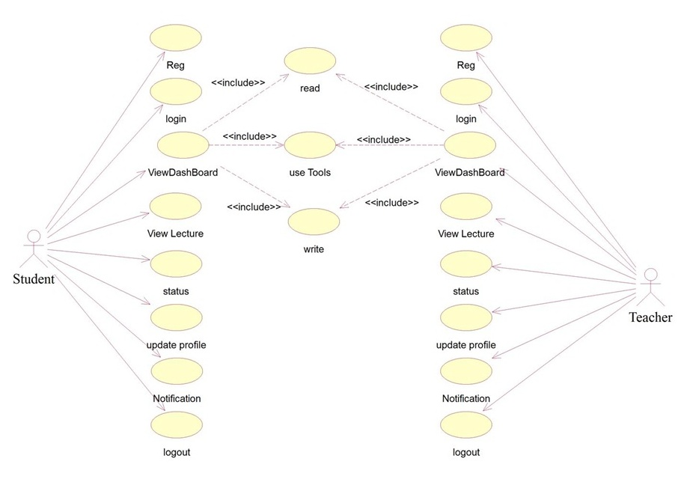
Use Case Diagram of Student and Teacher

Slide 10
Use Case of Student and Teacher
In this diagram student and teacher are actors.
Actor student and teacher does various functions such as Registration Login , Dash-board , View lectures , status ,Update profile, Notification and Log out.
FUNCTIONS
Through registration student/teacher gives their Details.
In login student/teacher gives their authorized ID and password.
In Dashboard function student/teacher can able to read, write and use tools.
In view lectured student/teacher can read the previous lecture as well as current lecture.
Through status student/teacher can able to see which teacher is taking the class.
Update profile function provide the facility of upgradation or editing of details.
Notification function provide the notification of teacher's lecture and status of classes.
log out function provide the facility of getting out of application.

Slide 11
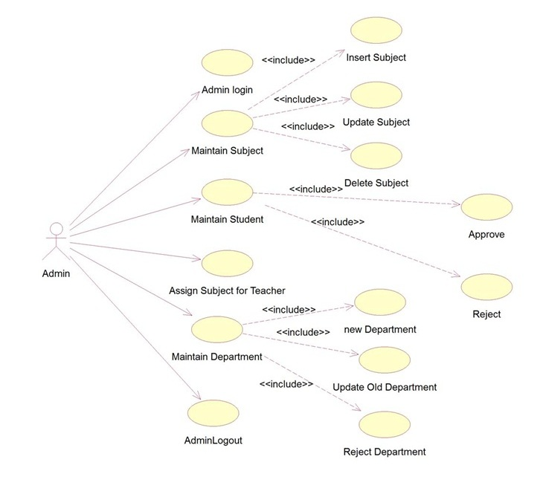
Use Case Diagram of Admin

Slide 12
Use Case of Administrator
In this diagram admin is an Actor which perform various functions. such as,
Admin login-> through this admin gives their authorized ID and password.
Maintain subject-> management of subjects which include insert subject, update subject, delete subject.
Maintain student-> management of student details and provide authentication by approval and rejection.
Assign subject for teacher
Maintain Department-> management of department which includes new Department, Update old department, reject department.
Admin log out-> admin function for getting out of application.

Slide 13
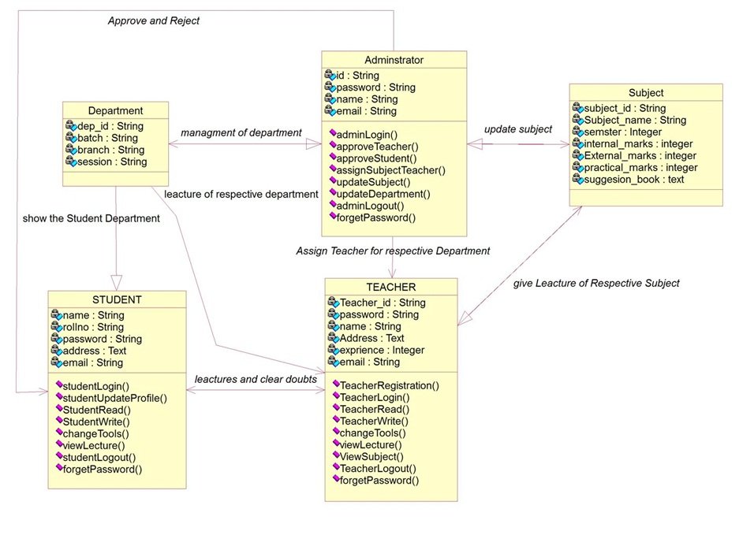
Class Diagram

Slide 14
Class Diagram
The class diagram includes administrator, department, teacher, student and subjects as an object and the relationships b/w them.
Administrator
Management of all department.
Approve and reject the student's ID and password.
Assign teacher for respective department.
update the subjects.
Department
Show the student department.
Lecture of respective department.
Student
Attend lectures and clear doubt.
Teacher
Gives lecture of respective subject.
Subject
update subject by admin.
teacher gives the lecture of respective subject.

Slide 15
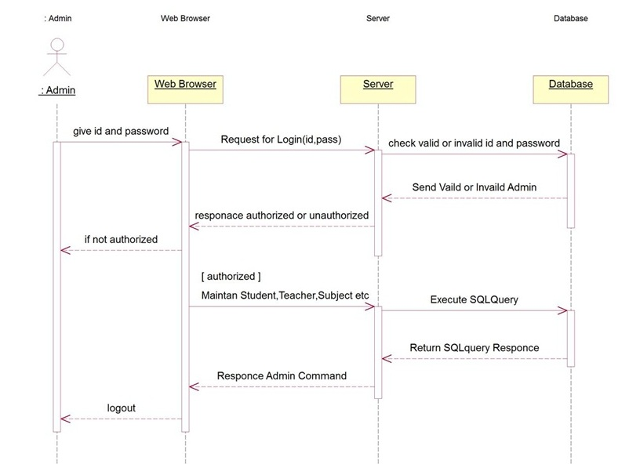
Sequence Diagram of Admin

Slide 16
Sequence Diagram of Admin
In sequence diagram admin is an object which operate with other objects.
Firstly , admin gives ID and password to the web browser.
Web browser request for log in to server.
Server response authorized or not, if not then web browser throws notification to admin.
Maintain of student, teacher and subject if authorized.

Slide 17
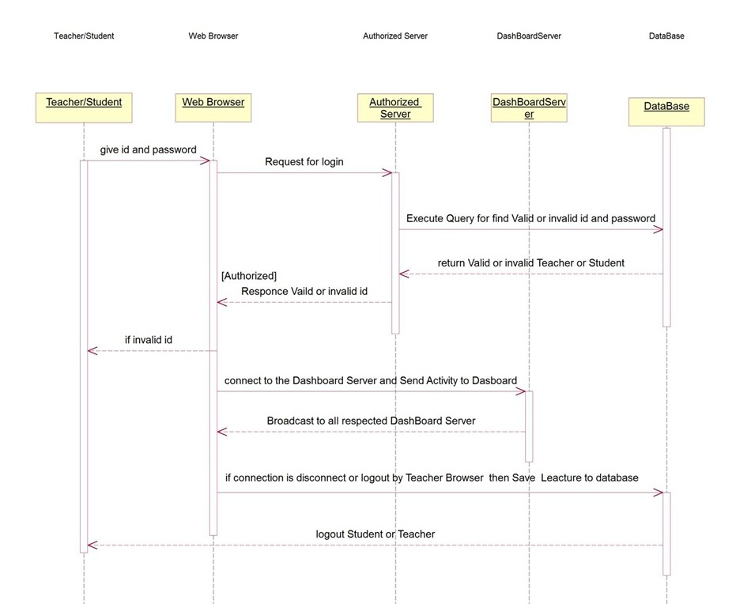
Sequence Diagram of Student and Teacher

Slide 18
Sequence Diagram Student Teacher
In sequence diagram admin is an object which operate with other objects.
Firstly, student/teacher gives ID and password to the web browser.
Web browser request for log in to authorized server.
Authorized Server response authorized or not, if not then web browser throws notification to student/teacher.
If authorized then go to dashboard server.
Teacher gives lecture and student attend lecture through Dashboard server.

Slide 19
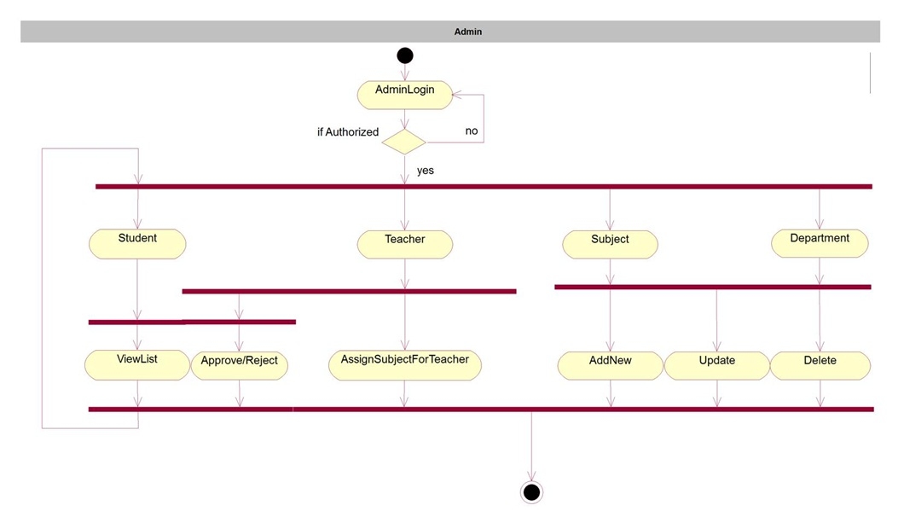
Activity Diagram of Admin

Slide 20
Activity Diagram of Admin
Start, then adminlogin and if authorized it will get few icons such as student , teacher , subject and department and if unauthorized adminlogin again.
Admin do two activities on student that is view list and approve/reject student.
Admin do one activity on teacher that is assign subject for teacher.
Admin do three activity on subject that is add new, update and delete.
Admin do three activity on department that is add new, update and delete.

Slide 21
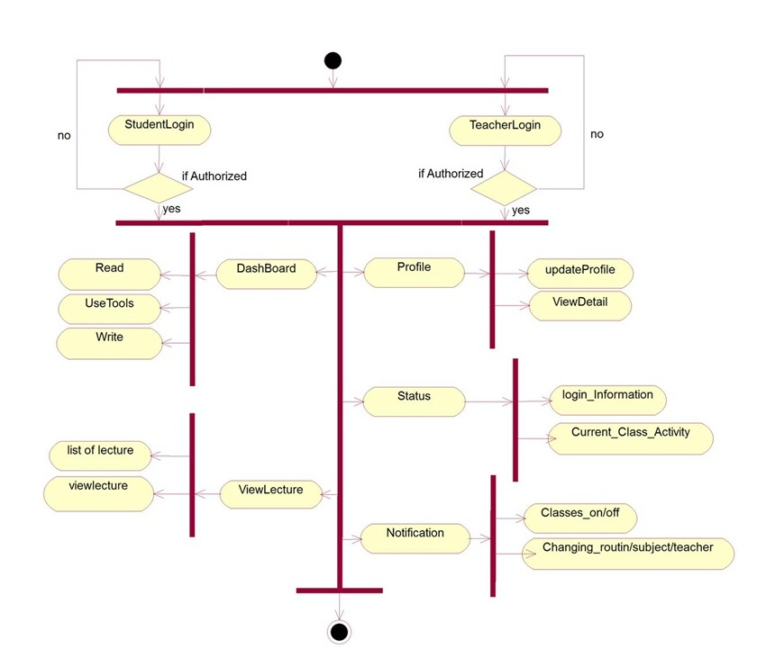
Activity Diagram of Student and Teacher

Slide 22
E-R Diagram 1
1 m
Bid
rollno
name
branch
Belong
Dob
batch
Batch
Student
session
Address
password
email
Did

Slide 23
E-R Diagram 2
n m
1
m
Tid
name
Address
Bid
Email
branch
Teaching
Batch
Teacher
batch
password
session
Experience
Assign
Subject
Suggest books
Sid
Practical marks
name
Internal marks
External marks

Slide 24
E-R Diagram 3
1 m
1
m
name
password
Aid
Tid
name
Address
Address
Approve
Reject
Email
Admin
Email
Teacher
password
Approve
Reject
Experience
Student
Did
rollno
Password
name
email
Dob
Address

Slide 25
Module 1 for Login And Registration
Two operation perform in module one
First is Registration of Admin , Student and Teacher
In Registration process Give Detail like Name, Address, Email , Photo etc. and get id and password.
Second is Login process for Authorized or not.
Give Login id and Password to Application
If Login id and Password is invalid Then come back to again login module 1
If Login id and Password is Valid then go to next modules Two

Slide 26
Module 2 for Admin
Admin will get few icons such as student , teacher , subject and department.
Admin do two activities on student that is view list and approve/reject student.
Admin do three activity on teacher that is assign subject for teacher , view list and approve/reject Teacher.
Admin do three activity on subject that is add new,update and delete.
Admin do three activiy on department that is add new,update and delete.

Slide 27
Module 2 for Student and Teacher
They will get few icons such as profile , status , View Lectures , Dashboard and Notification.
In profile Student and Teacher can update profile and View Details
Status is Show some information like login information and current classes Activity.
In View Lectures icon show list of lectures and View lectures
Dashboard is Perform Three Action Read Teacher Lecture, write Student Query and use tools of Application
Notification is Show class is on or off and also show if changing Routine ,Subject ,Teacher etc.

Slide 28
DataBase
Batch table
B_id | Branch | Batch
100001 | CSE | 2K13
100002 | ECE | 2K13
100004 | CSE | 2K14
100005 | ECE | 2K14
Student table
rollno | passwrd | name | Address | email | B_id | Approve
1403027 | **** | R.K | ranchi | abc@gmail.com | 100001 | true
1403050 | **** | R.K | ranchi | xyz@gmail.com | 100002 | false
13/155 | **** | A.K | lalpur | a@gmail.com | 100001 | true
13/232 | **** | B.K | katatoli | b@gmail.com | 100004 | true

Slide 29
Database
Teacher Table
T_id | password | name | Address | email | Approve
T10001 | #### | A.K | Ranchi | W@gmail.com | true
T10002 | #### | B.K | Ranchi | Q@gmail.com | true
Subject Table
Sub_id | name | internal | external | practical | Sugg_book
S10001 | C | 25 | 50 | 0 | Let us C
S10002 | D. S. | 50 | 100 | 50 | D.S with C
Assign Subject
T_id | B_id | Sub_id | complete
T10001 | 100001 | S10002 | false
T10002 | 100002 | S10001 | false

Slide 30
IMPLEMENTATION OF MODULES

Slide 31
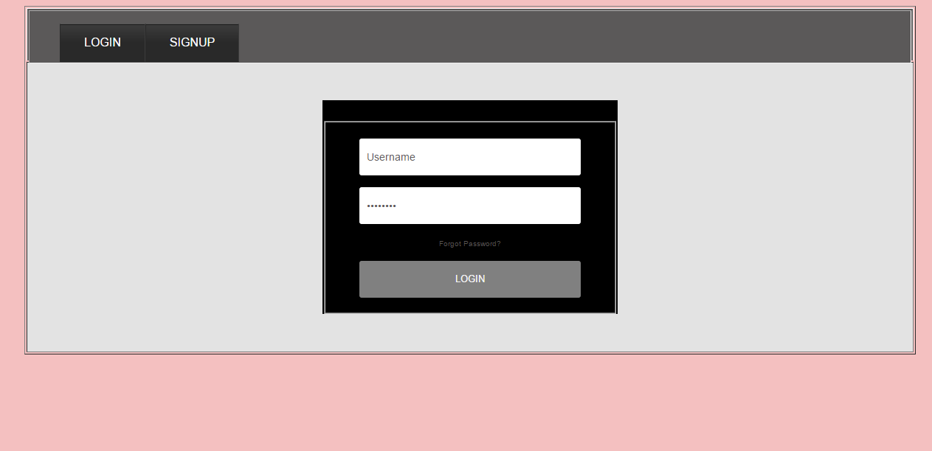
SIGNUP AND LOGIN PANEL

Slide 32
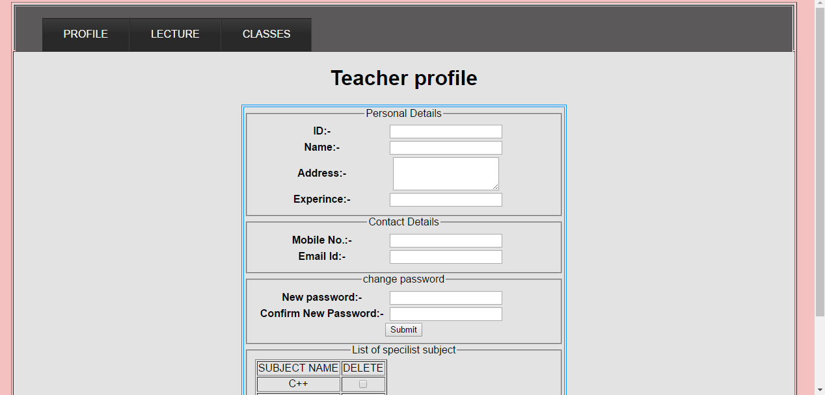
Teacher Profile

Slide 33
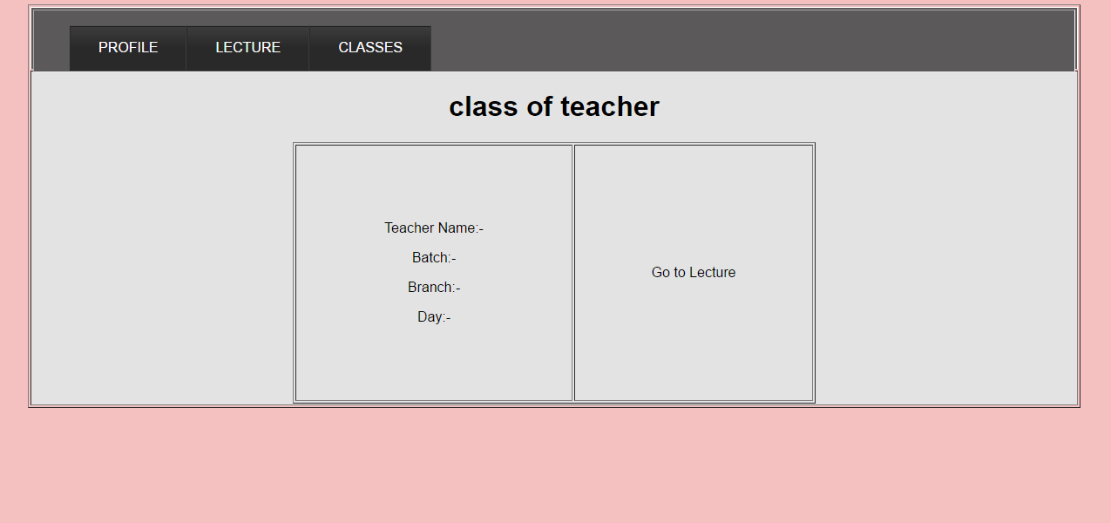
Class of Teacher

Slide 34
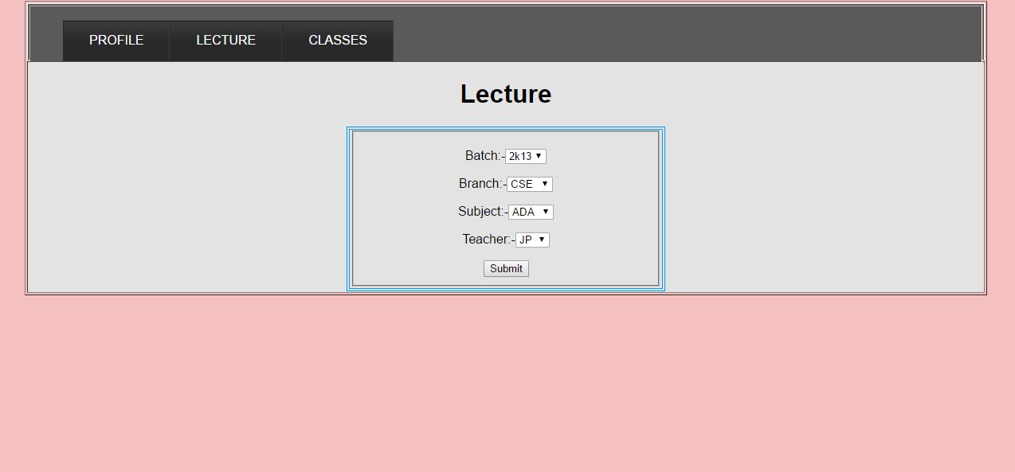
Lecture

Slide 35
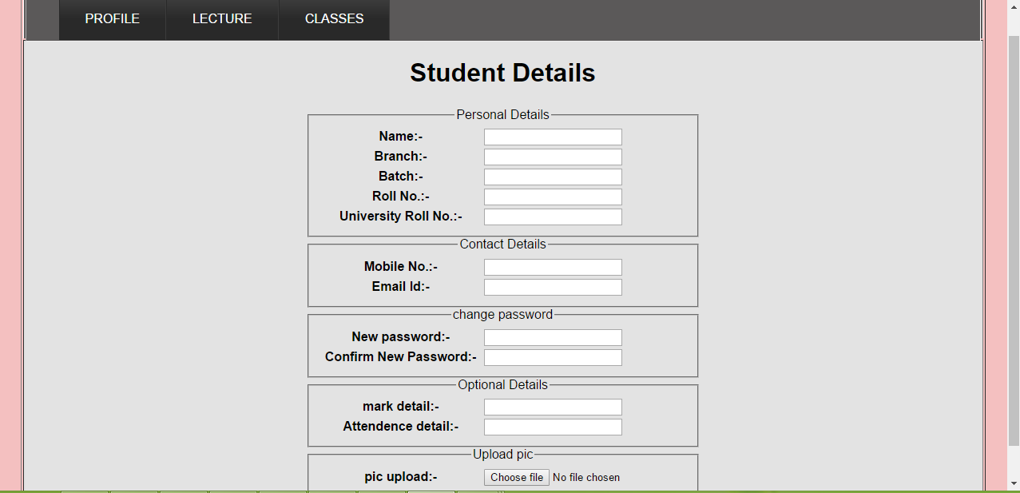
Student profile

Slide 36
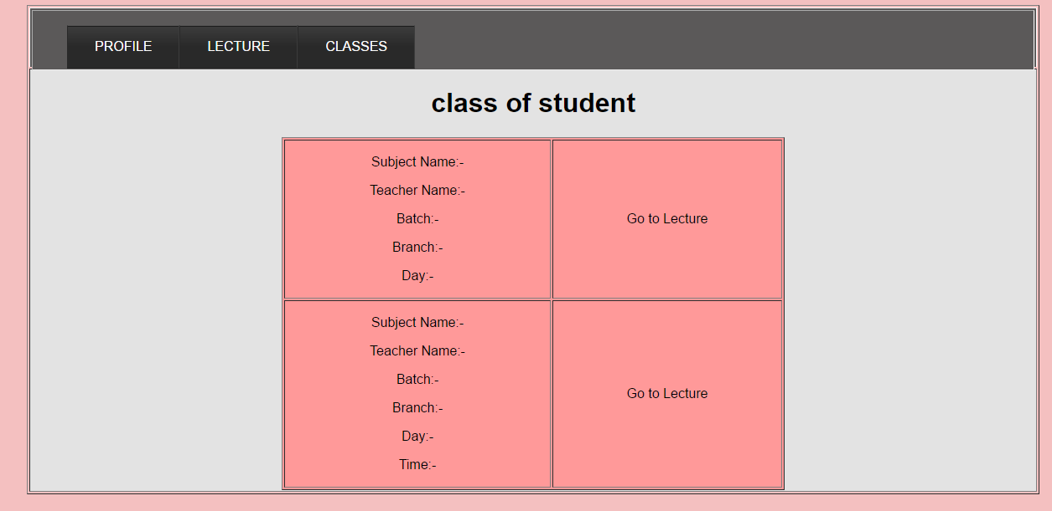
Class of student

Slide 37
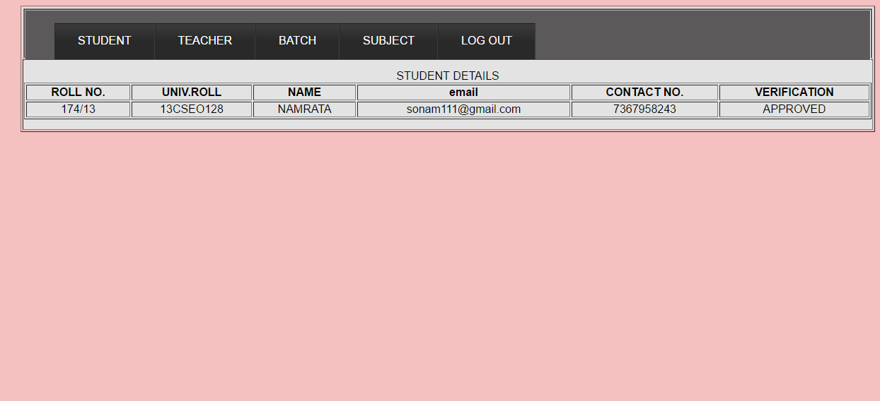
Admin(student details)

Slide 38
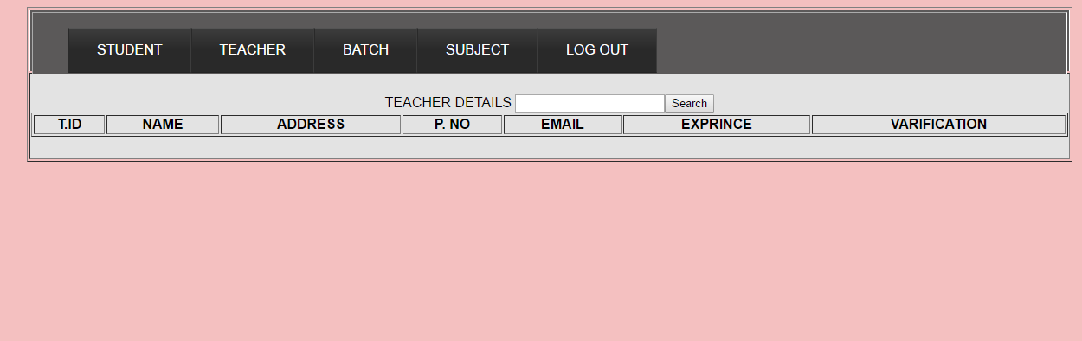
Admin(Teacher details)

Slide 39
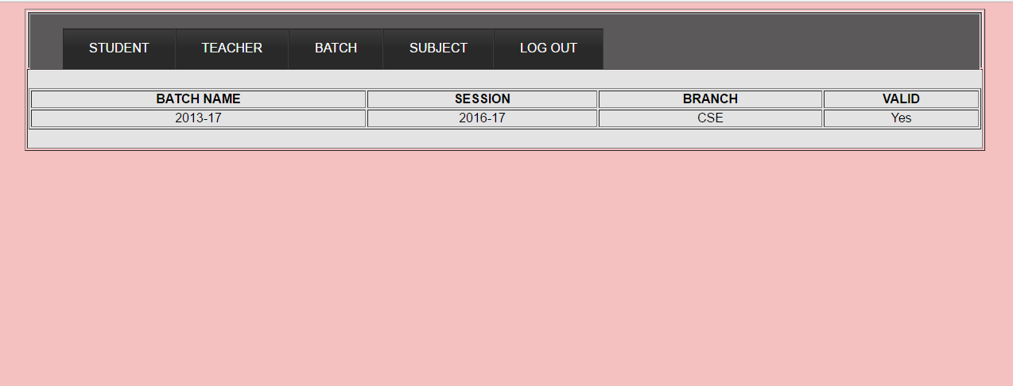
Admin(list of batch)

Slide 40
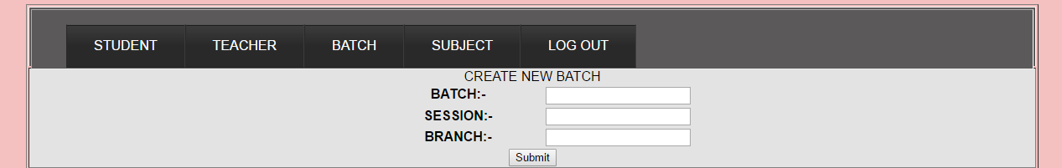
Admin(create new batch)

Slide 41
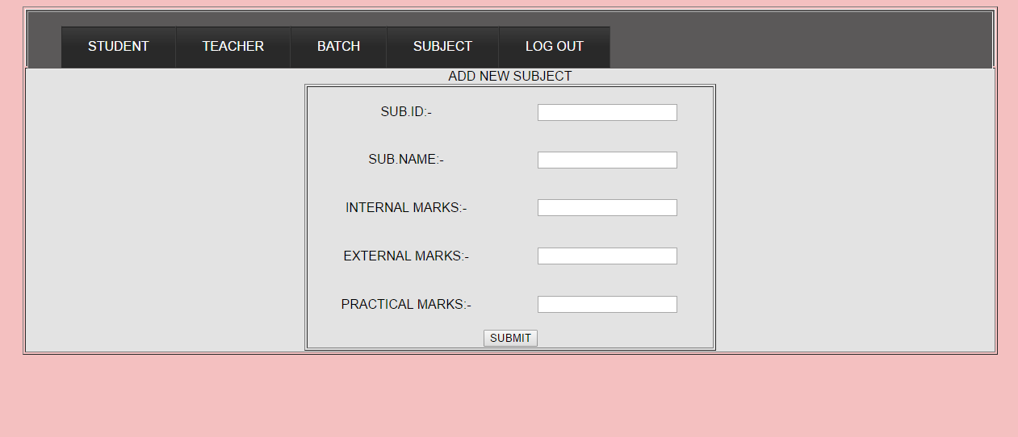
Admin(add new subject)

Slide 42
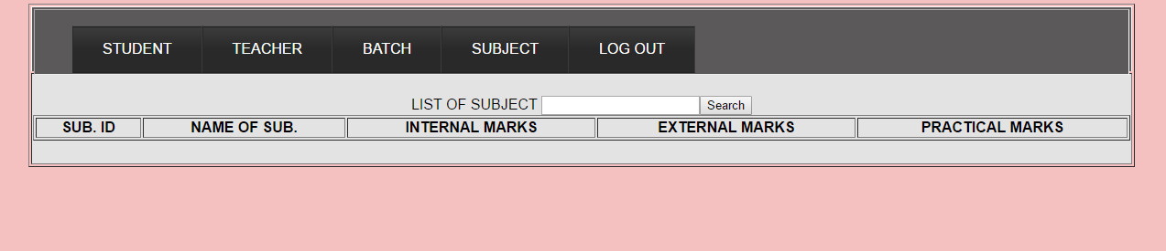
Admin(list of subject)

Slide 43
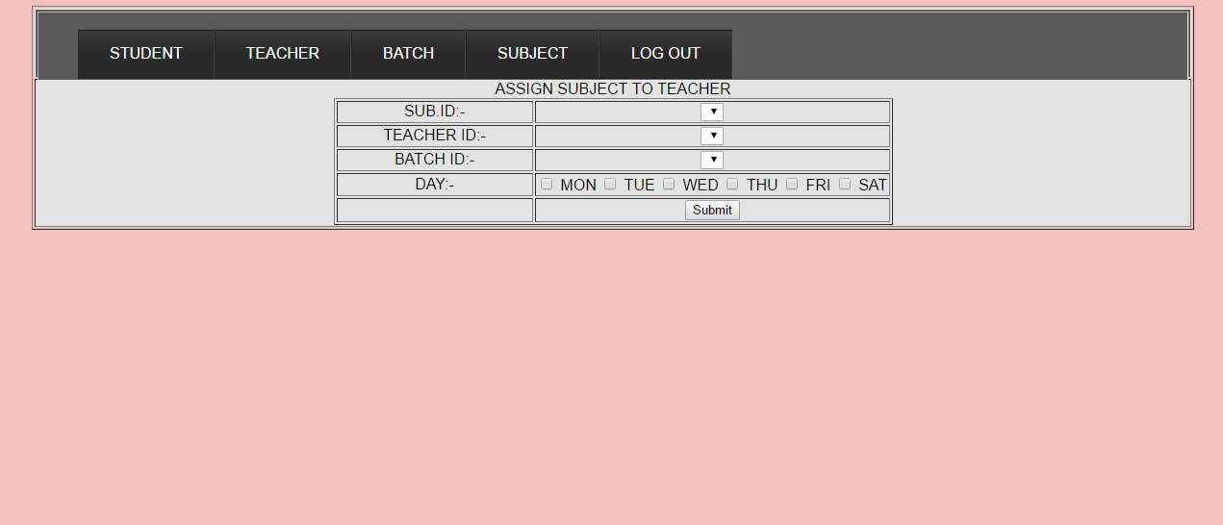
Admin(assign sub. to teacher)

Slide 44
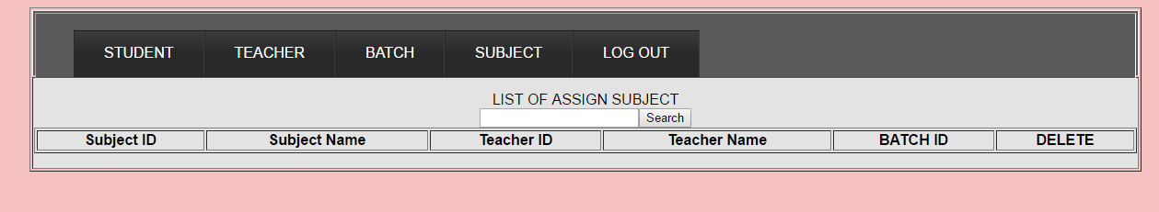
Admin(list of assign sub.)

Slide 45
THANK YOU

